Slide 1
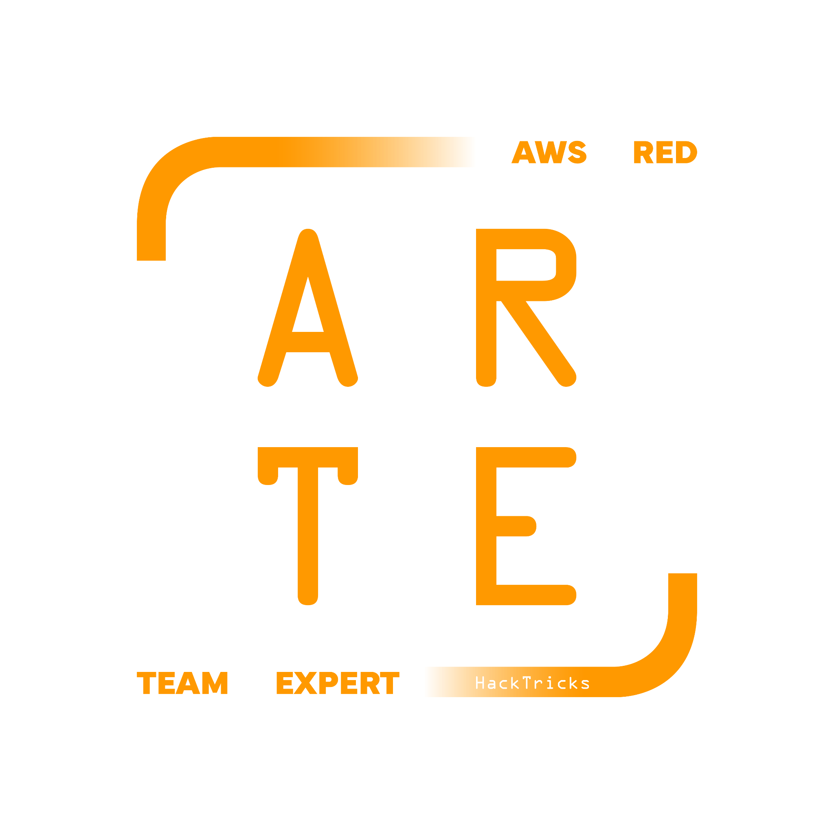
STS
Security Token Service
HackTricks Training
https://t.me/CyberFreeCourses

Slide 2
Manual Enumeration
# Get basic info of the creds
aws sts get-caller-identity
aws sts get-access-key-info --access-key-id <AccessKeyID>
# Get CLI a session token with current creds
## Using CLI creds
## You cannot get session creds using session creds
aws sts get-session-token
## MFA
aws sts get-session-token --serial-number <arn_device> --token-code <otp_code>
## Assume a role
aws sts assume-role \
--role-arn arn:aws:iam::123456789012:role/example-role \
--role-session-name example-session
https://t.me/CyberFreeCourses
From https://cloud.hacktricks.xyz/pentesting-cloud/aws-pentesting/aws-services/aws-iam-and-sts-enum#sts

Slide 3
Assume Role Logic
In order to assume a role in the same account if the role to assume is allowing specifically a role ARN like in:
{
"Version": "2012-10-17",
"Statement": [
{
"Effect": "Allow",
"Principal": {
"AWS": "arn:aws:iam::<acc_id>:role/priv-role"
},
"Action": "sts:AssumeRole",
"Condition": {}
}
]
}
The role priv-role in this case, doesn't need to be specifically allowed to assume that role (with that allowance is enough).
https://t.me/CyberFreeCourses
From https://cloud.hacktricks.xyz/pentesting-cloud/aws-pentesting/aws-services/aws-iam-and-sts-enum#sts

Slide 4
Assume Role Logic
However, if a role is allowing an account to assume it, like in:
{
"Version": "2012-10-17",
"Statement": [
{
"Effect": "Allow",
"Principal": {
"AWS": "arn:aws:iam::<acc_id>:root"
},
"Action": "sts:AssumeRole",
"Condition": {}
}
]
}
The role trying to assume it will need a specific sts:AssumeRole permission over that role to assume it.
If you try to assume a role from a different account, the assumed role must allow it (indicating the role ARN or the external account), and the role trying to assume the other one MUST have permissions to assume it (in this case this isn't optional even if the assumed role is specifying an ARN).
https://t.me/CyberFreeCourses
From https://cloud.hacktricks.xyz/pentesting-cloud/aws-pentesting/aws-services/aws-iam-and-sts-enum#sts

Slide 5
Unauthenticated Access
Same as for IAM (STS & IAM are closely related).
More info in https://cloud.hacktricks.xyz/pentesting-cloud/aws-pentesting/aws-unauthenticated-enum-access/aws-iam-and-sts-unauthenticated-enum
https://t.me/CyberFreeCourses

Slide 6
Privilege Escalation
There are a few IAM privescs for STS:
sts:AssumeRole
Not always needed
sts:AssumeRoleWithSAML
A trust policy with this role grants users authenticated via SAML access to impersonate the role.
sts:AssumeRoleWithWebIdentity
This permission grants permission to obtain a set of temporary security credentials for users who have been authenticated in a mobile, web application, EKS... with a web identity provider
https://t.me/CyberFreeCourses
From https://cloud.hacktricks.xyz/pentesting-cloud/aws-pentesting/aws-privilege-escalation/aws-sts-privesc

Slide 7
Post Exploitation
From token Creds to Console:
It’s possible to access the console using cli credentials of a user with console access without knowing his username or password.
https://github.com/NetSPI/aws_consoler
https://github.com/99designs/aws-vault
More in https://cloud.hacktricks.xyz/pentesting-cloud/aws-pentesting/aws-post-exploitation/aws-sts-post-exploitation
https://t.me/CyberFreeCourses

Slide 8
Persistence
Role chaining is a recognized functionality of AWS useful to maintain stealth persistence. As you can assume role to assume another one to assume the first one (indefinitely).
When a role is assumed, the expiration field of the credentials is refreshed. Therefore, is 2 roles can assume each other, it's possible to continuously get new credentials.
Moreover, note that temporary tokens cannot be listed, so maintaining an active temporary token is a way to maintain stealth persistence.
https://t.me/CyberFreeCourses
From https://cloud.hacktricks.xyz/pentesting-cloud/aws-pentesting/aws-persistence/aws-iam-and-sts-persistence

